Slide 1
SQI_{SIGN}
Isogeny-Based Digital Signature Scheme
Osasere Imade
Abdul Mutallif
Anjiya Shrestha
Matthew Withee
Suresh Yhap
Midterm Research Paper
CS381/780 – Post Quantum Cryptography
Dr. Delaram Kahrobaei
Queens College, Fall 2024

Slide 2





Osasere Imade
Abdul Mutallif
Anjiya Shrestha
Matthew Withee
Suresh Yhap

Slide 3
Chapter 1
Introduction

Slide 4
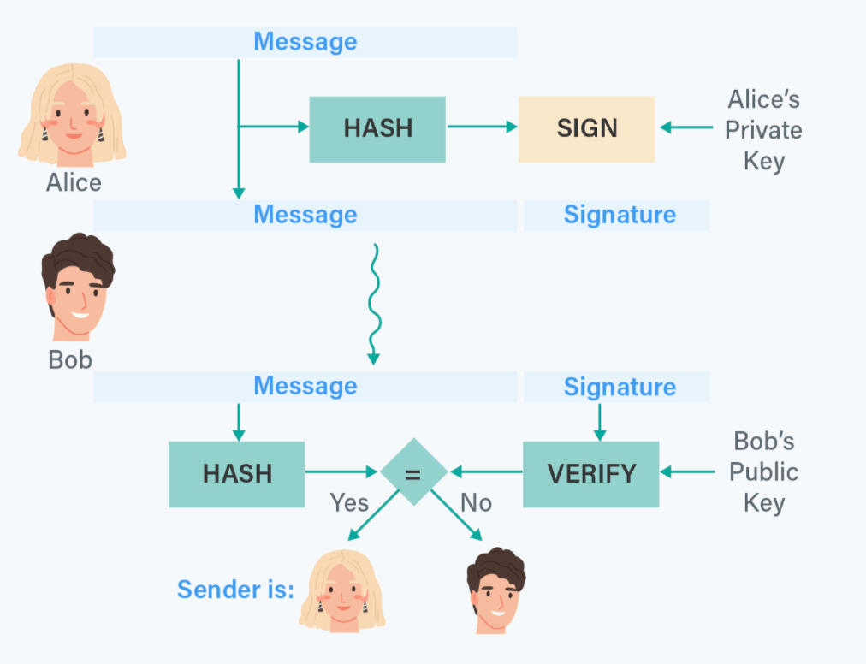
Digital Signature Review
Alice has a message to send to Bob
Alice creates a hash of the message
Alice signs the hash with her private key
Alice sends Bob the message and signature
Bob receives the message and signature
Bob verifies the hash to ensure message integrity
Bob verifies the signature to ensure the message came from Alice
The message is received!

Slide 5
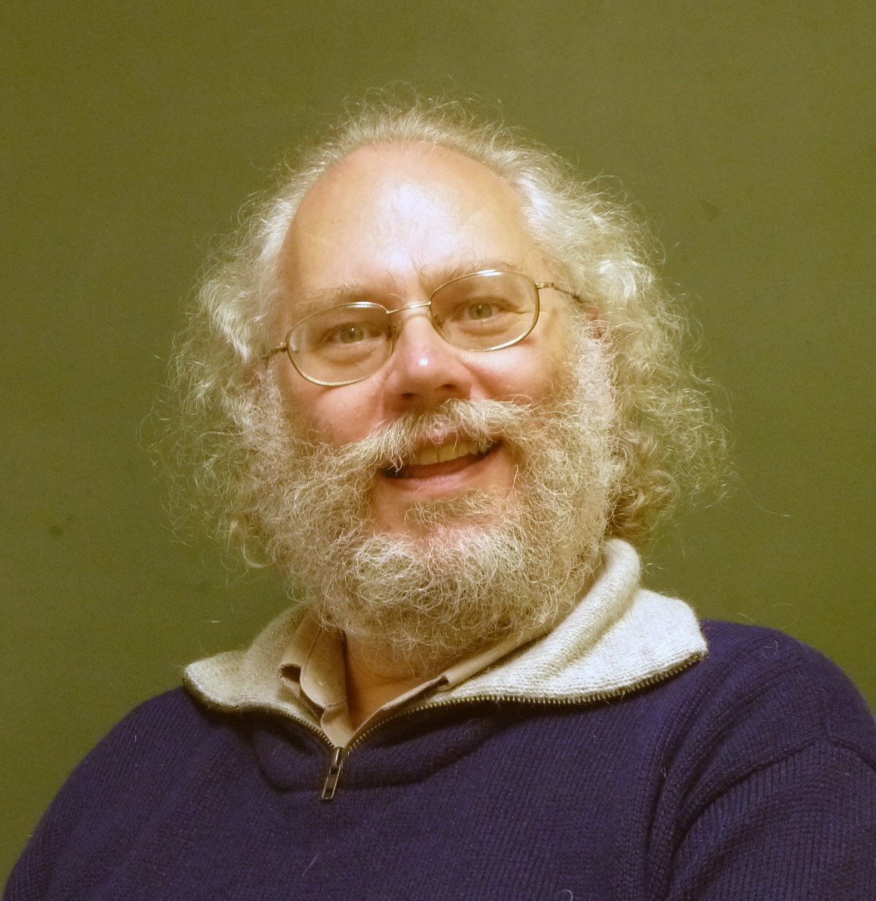
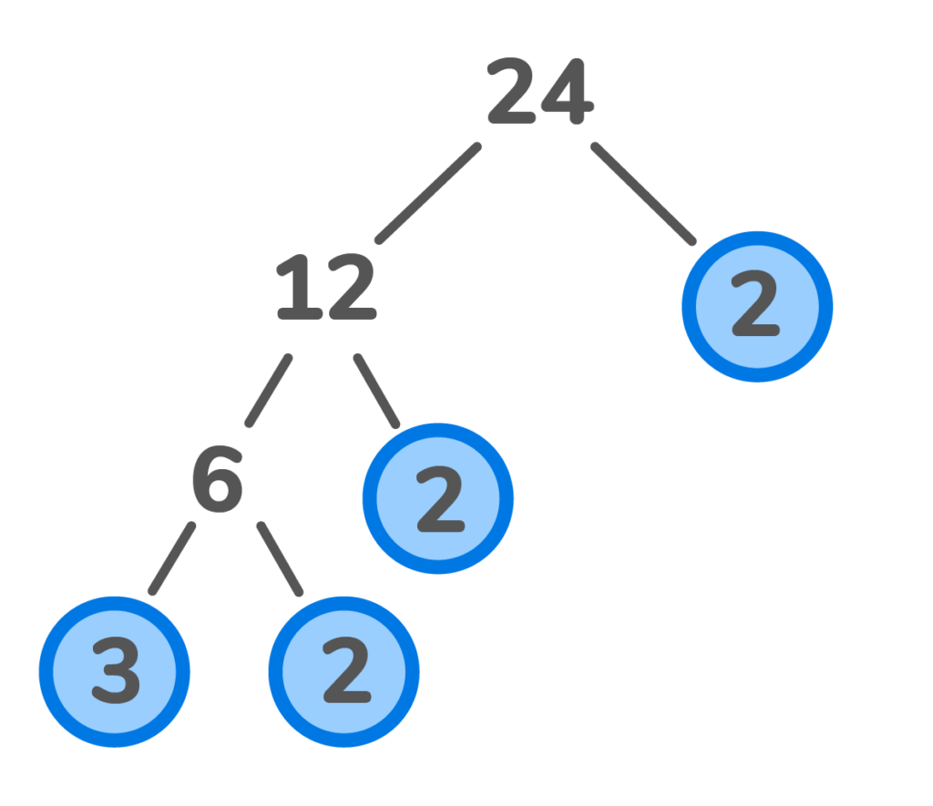
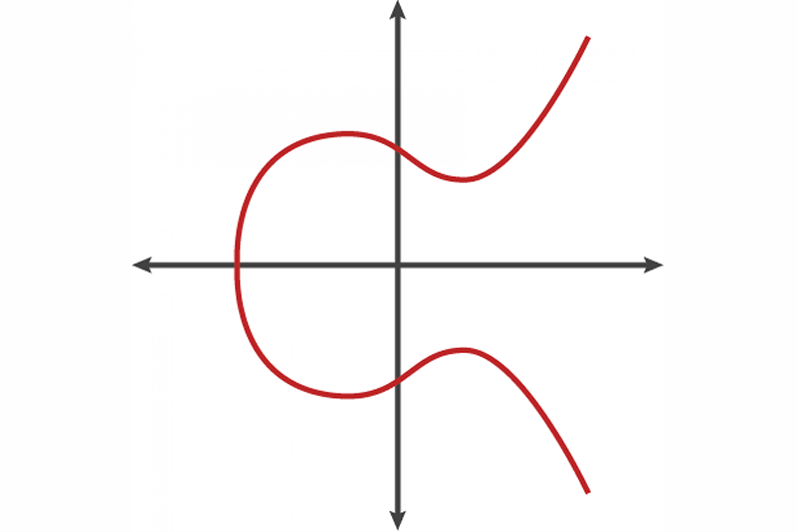
Traditional Digital Signature Schemes
Rivest-Shamir-Adelman (RSA)
Elliptic Curve Cryptography (ECC)

Slide 6
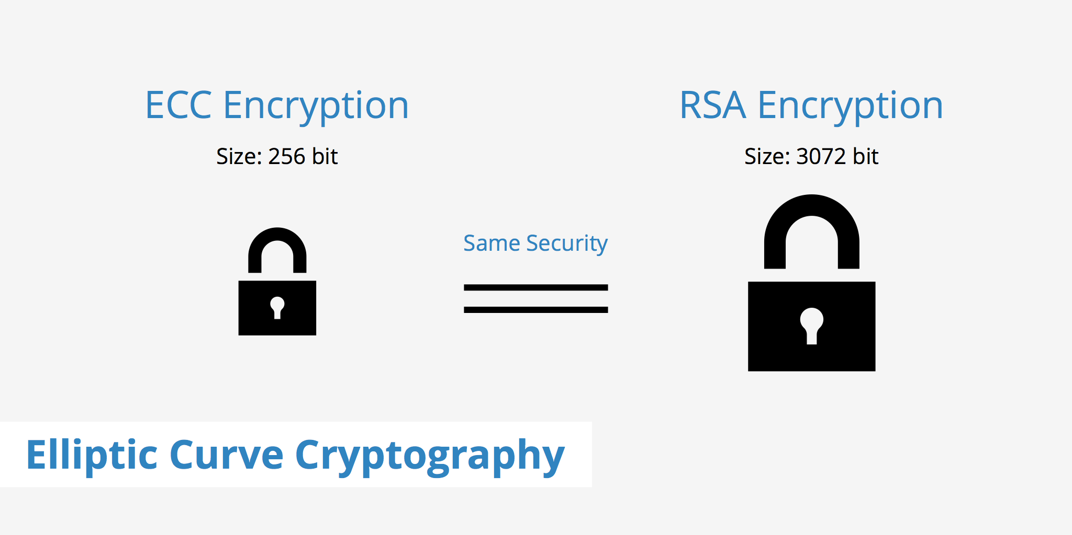
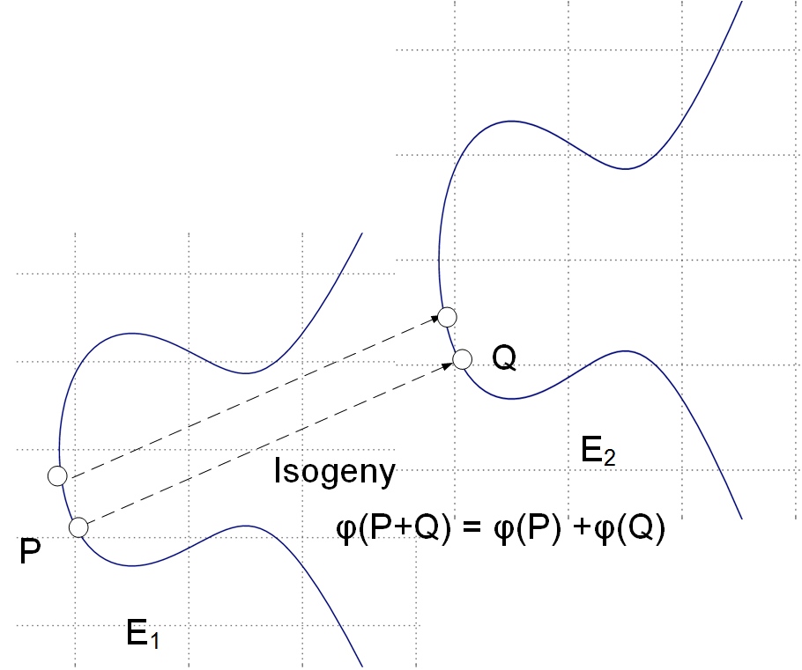
Isogeny-Based Signature Schemes
The “hard problem” is computing an isogeny
The isogeny is Alice’s private key
The destination is the public key

Slide 7
SQI_{SIGN}
Short Quaternion Isogeny-Based Signature Scheme
Uses supersingular elliptic curves
The endomorphism ring of supersingular elliptic curves can be represented using quaternions.

Slide 8
Advantages & Disadvantages
Advantages
Compact signature size
No easy solution to problem
Elegant
Disadvantages
A lot of computational overhead
Difficult to implement
New field of study
Potentially vulnerable

Slide 9
Chapter 2
Basic Operations

Slide 10
Abelian group
Set Magma Semigroup Monoid
Abelian group Group

Slide 11
Field
(S, +)
a(b + c) = ab + ac (F, +, x)
(S \ {0}, x)

Slide 12
Section 2.2 - Elliptic Curves
Montgomery elliptic curves are curves of the form: By² = x³ + Ax² + x
We also importantly consider a “point at infinity”, ∞, to be part of the curve

Slide 13
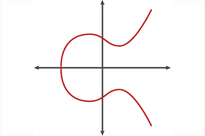
Elliptic curve over the real numbers

Slide 14
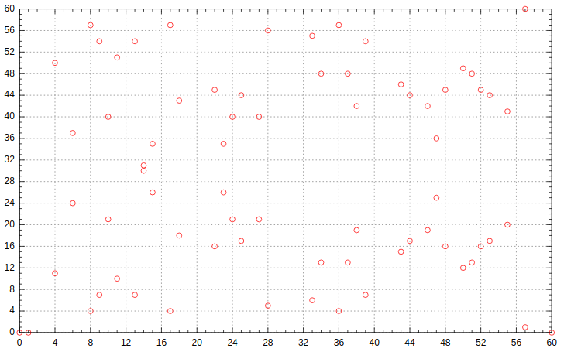
An elliptic curve over the finite field, F₆₁

Slide 15
Group structure of elliptic curves
Collectively supplementing the points on the elliptic curve with a binary addition operation yields an abelian group!
Define the additive identity to be the point at infinity, ∞. So, for a point P on the elliptic curve, P + ∞ = ∞ + P = P.
To add two points on the curve, draw a line of intersection through the points. The third point of intersection is defined as the negation of the sum of the points. This is because we define the sum of three points of intersection on a line as ∞.
To get the correct sum, reflect this point over the x-axis.
Note the third point may be ∞ if the line is vertical

Slide 16
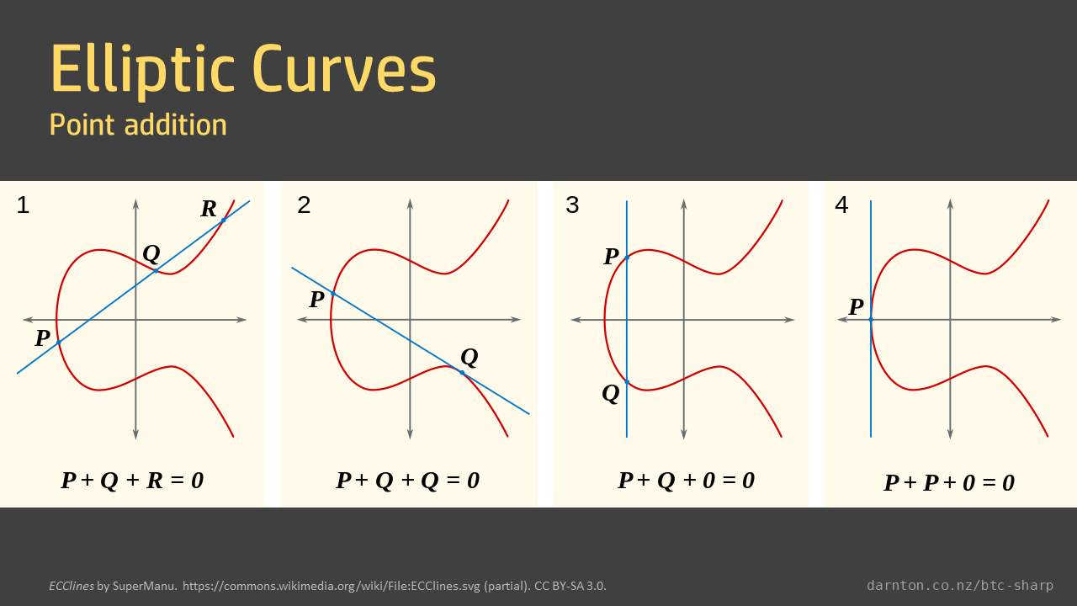

Slide 17
Discrete logarithm problem
Scalar multiplication can be defined using repeated point doubling and addition
It is denoted: [k]P
Since we are dealing with repeated applications of an abelian group’s operation, we can naturally define a discrete log problem:
Given a point P and a scalar multiple [k]P, find k
Now knowing how “strangely” addition works and how unrelated the sum of points seem to the original points, you can imagine how difficult solving the discrete log problem will be for large k

Slide 18
Isogenies
An isogeny φ of elliptic curves is a non-zero map E1 → E2 that is
‣ given by rational functions φ(P + Q) = φ(P) + φ(Q)
‣ that is a group homomorphism f(x, y) /g(x, y), where f , g are polynomials

Slide 19
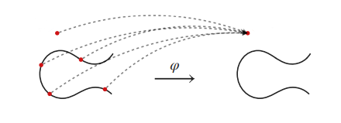
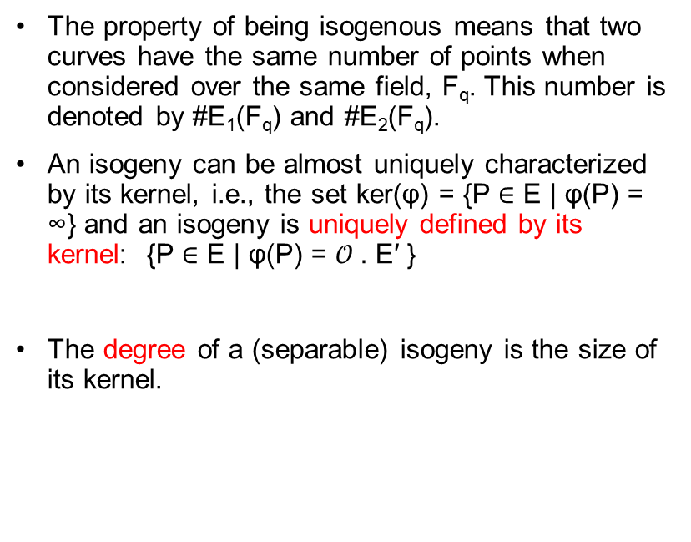
Isogenies
The property of being isogenous means that two curves have the same number of points when considered over the same field, F_{q}​. This number is denoted by #E₁(F_{q}) and #E₂​(F_{q}​).
An isogeny can be almost uniquely characterized by its kernel, i.e., the set ker(φ) = {P ∈ E | φ(P) = ∞} and an isogeny is uniquely defined by its kernel: {P ∈ E | φ(P) = 𝒪 $.$ E′ }
The degree of a (separable) isogeny is the size of its kernel.

Slide 20
Isogenies
Example: For each m≠0, the multiplication-by-m map
[m]:E → E
is an isogeny from E to itself.
If m≠0 in the base field, its kernel is
E[m] ≅ Z/m × Z/m .
Thus, [m] is a degree-m^2 isogeny.

Slide 21
Isogenies
Unique Isogeny: When given a subgroup (a smaller set that behaves like the larger group) G of points on E1​, there is one specific way to create an isogeny from E1​ to E2.
If you know a subgroup G of E1​ with size N, there is a unique isogeny of degree N with the subgroup G as its kernel, ker(φ) = G.
Dual Isogeny: For every isogeny φ, there’s another isogeny that goes in the reverse direction, called the dual isogeny φ​.
Composition: When we combine the original isogeny and its dual, it’s similar to multiplying all points on E1​ by a number N. This number is the same as the degree of the isogeny.

Slide 22
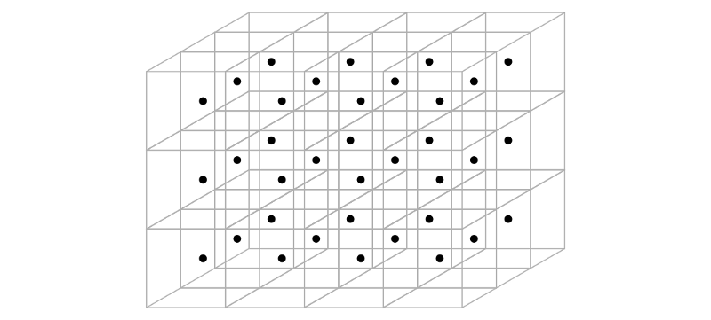
Introduction to Lattices and Cryptography

Slide 23
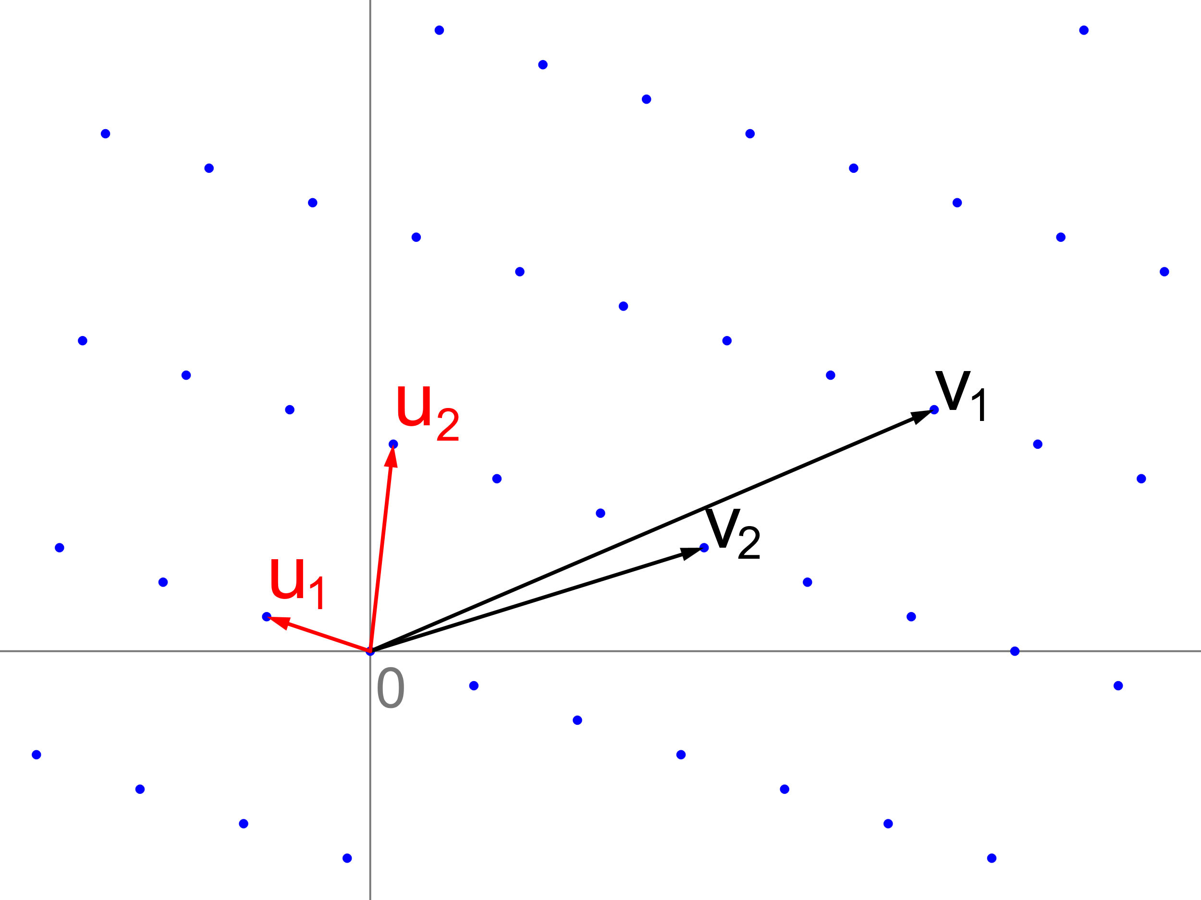
Lattice Basis Reduction: Short Basis Algorithm

Slide 24
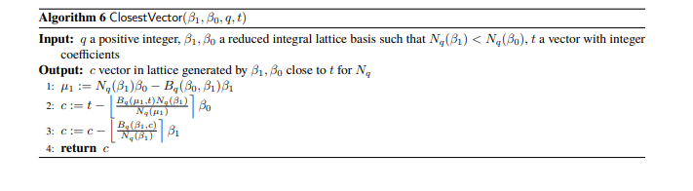
Finding the Closest Vector

Slide 25
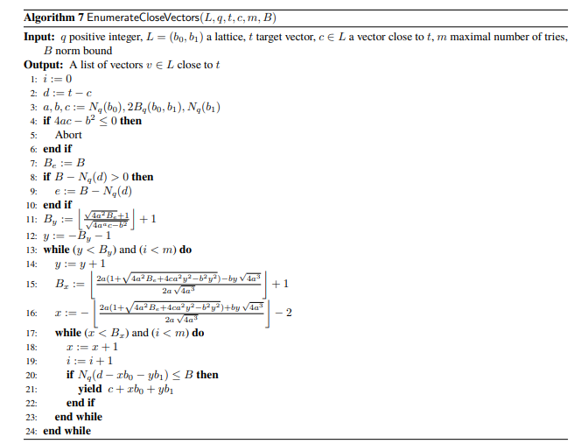
Enumerating Close Vectors

Slide 26
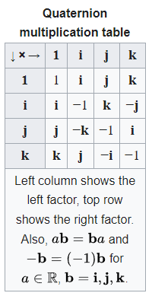
Quaternion Arithmetic and the Orders and Ideals

Slide 27
Solving Norm Equations
Isogeny-Based Cryptography

Slide 28
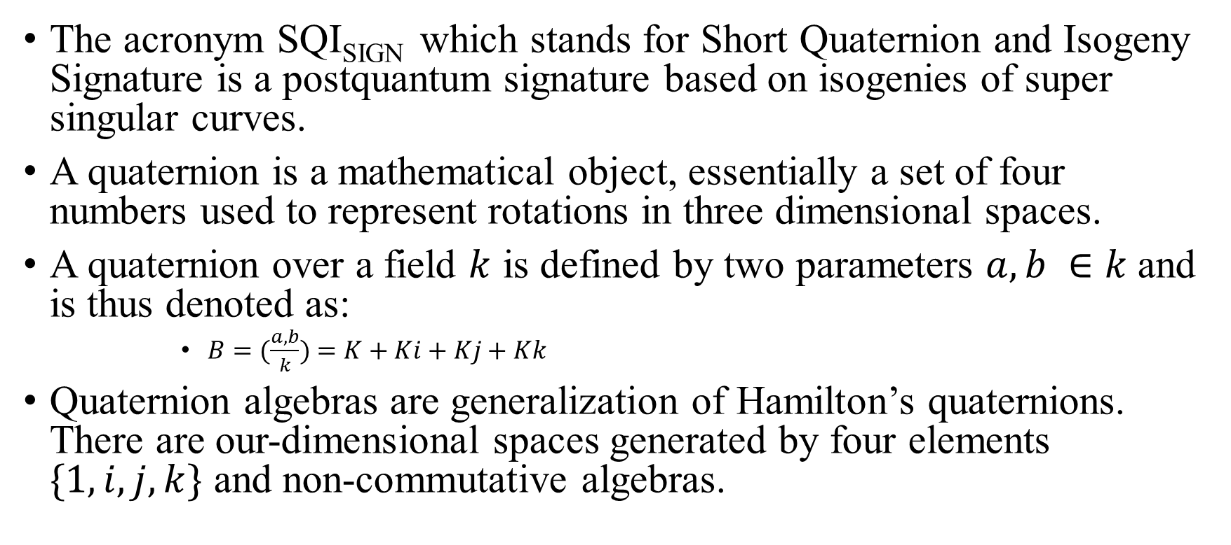
Background
The acronym SQI_{SIGN} which stands for Short Quaternion and Isogeny Signature is a postquantum signature based on isogenies of super singular curves.
A quaternion is a mathematical object, essentially a set of four numbers used to represent rotations in three dimensional spaces.
A quaternion over a field $k$ is defined by two parameters $a, b ∈k$and is thus denoted as:
      $B=(\frac{a, b}{k})$ $=K+Ki+Kj+Kk$
Quaternion algebras are generalization of Hamilton’s quaternions. There are our-dimensional spaces generated by four elements $\{1, i, j, k\}$ and non-commutative algebras.

Slide 29
Key Concepts and Definitions
Isogeny in mathematics refer to the special kind of map between two algebraic structures.
A norm is a function from a real or complex vector space to the non-negative real numbers that behave in a certain way like the distance from the origin. An example is:
  Vectors can be arrows on a flat surface (for a 2D space) or in the air (for a 3D space). The norm of a vector can be compared to measuring the length of these arrows.
There are various kinds of norms which include:
  The Equivalent norm
  The absolute value norm
  The Euclidean norm

Slide 30
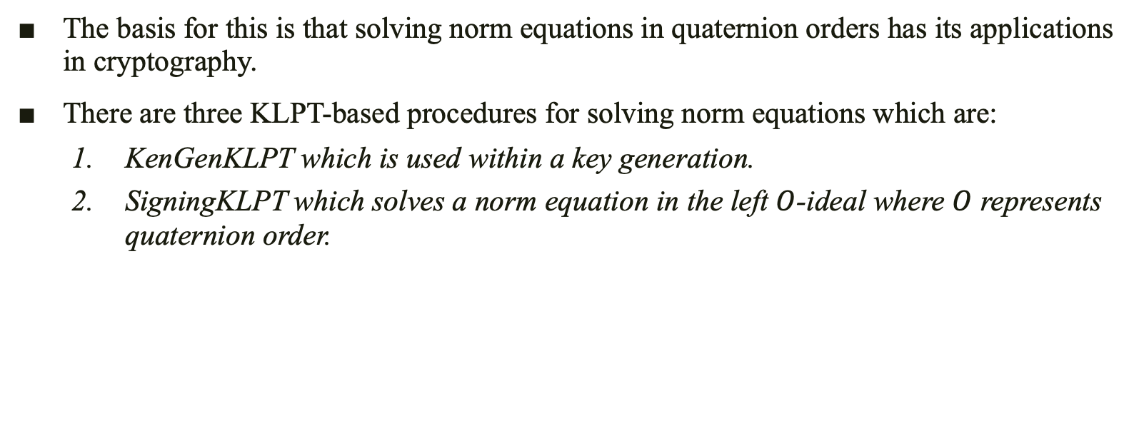
Introduction to the Algorithm
The basis for this is that solving norm equations in quaternion orders has its applications in cryptography.
There are three KLPT-based procedures for solving norm equations which are:
  KenGenKLPT which is used within a key generation.
  SigningKLPT which solves a norm equation in the left $O$-ideal where $O$ represents quaternion order.

Slide 31
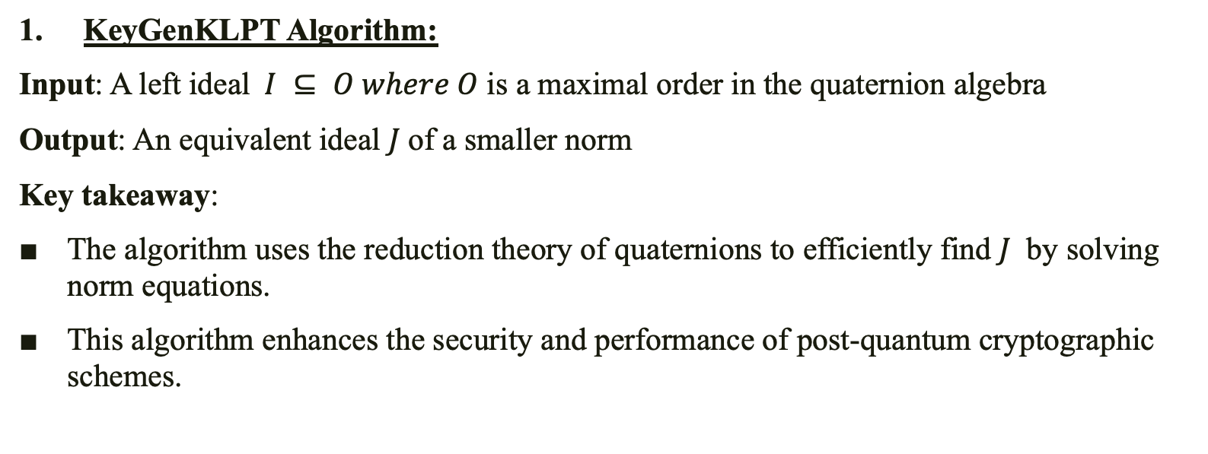
Algorithm Process Overview
KeyGenKLPT Algorithm:
Input: A left ideal $I ⊆ O where O$ is a maximal order in the quaternion algebra
Output: An equivalent ideal $J$of a smaller norm
Key takeaway:
The algorithm uses the reduction theory of quaternions to efficiently find $J$ by solving norm equations.
This algorithm enhances the security and performance of post-quantum cryptographic schemes.

Slide 32
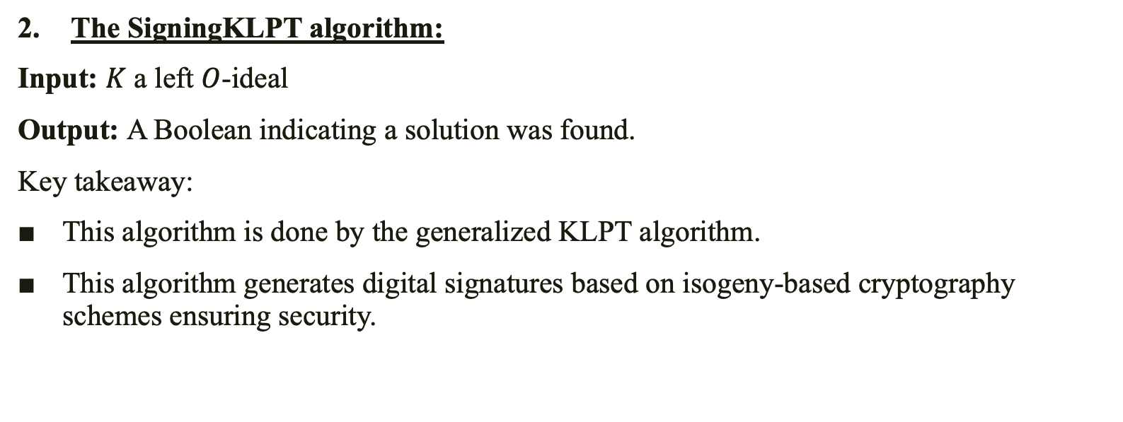
Algorithm Process Overview
The SigningKLPT algorithm:
Input: $K$ a left $O$-ideal
Output: A Boolean indicating a solution was found.
Key takeaway:
This algorithm is done by the generalized KLPT algorithm.
This algorithm generates digital signatures based on isogeny-based cryptography schemes ensuring security.

Slide 33
Algorithm Process Overview
The process of solving norm equations in quaternion orders and ideals can also be seen various algorithms which includes:
Cornacchia’s algorithm.
Representing Integers by smaller numbers.

Slide 34
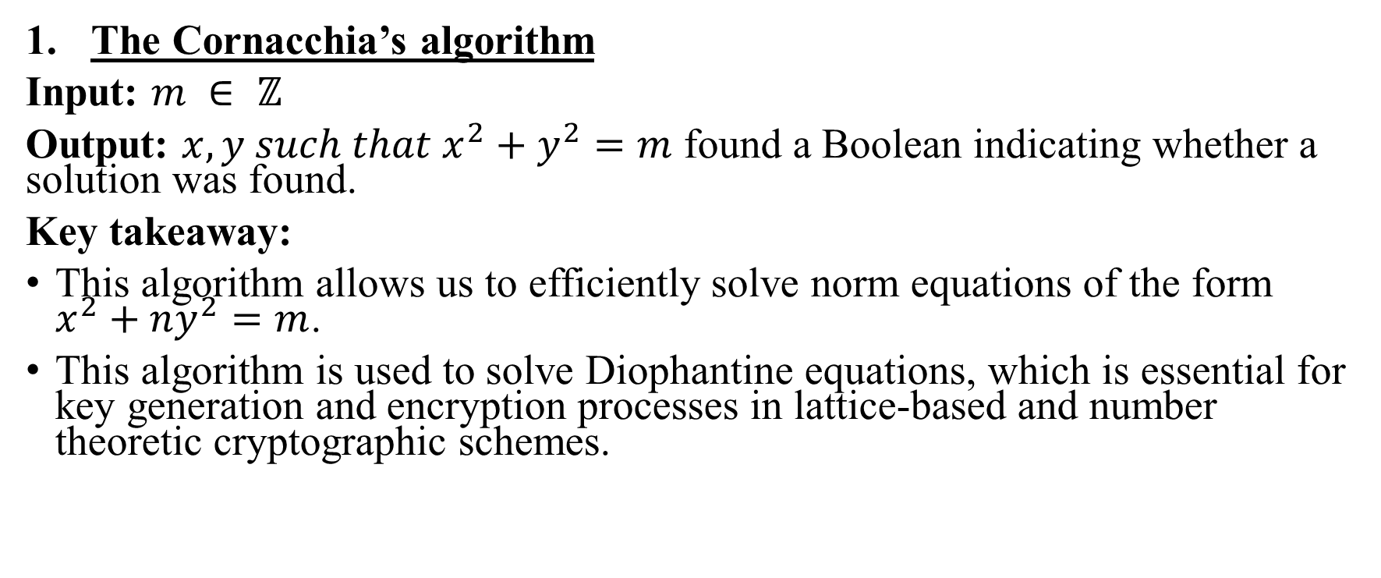
Algorithm Process Overview
The Cornacchia’s algorithm
Input: $m ∈ ℤ$
Output: $x, y such that x^{2}+y^{2}=m$ found a Boolean indicating whether a solution was found.
Key takeaway:
This algorithm allows us to efficiently solve norm equations of the form $x^{2}+ny^{2}=m$.
This algorithm is used to solve Diophantine equations, which is essential for key generation and encryption processes in lattice-based and number theoretic cryptographic schemes.

Slide 35
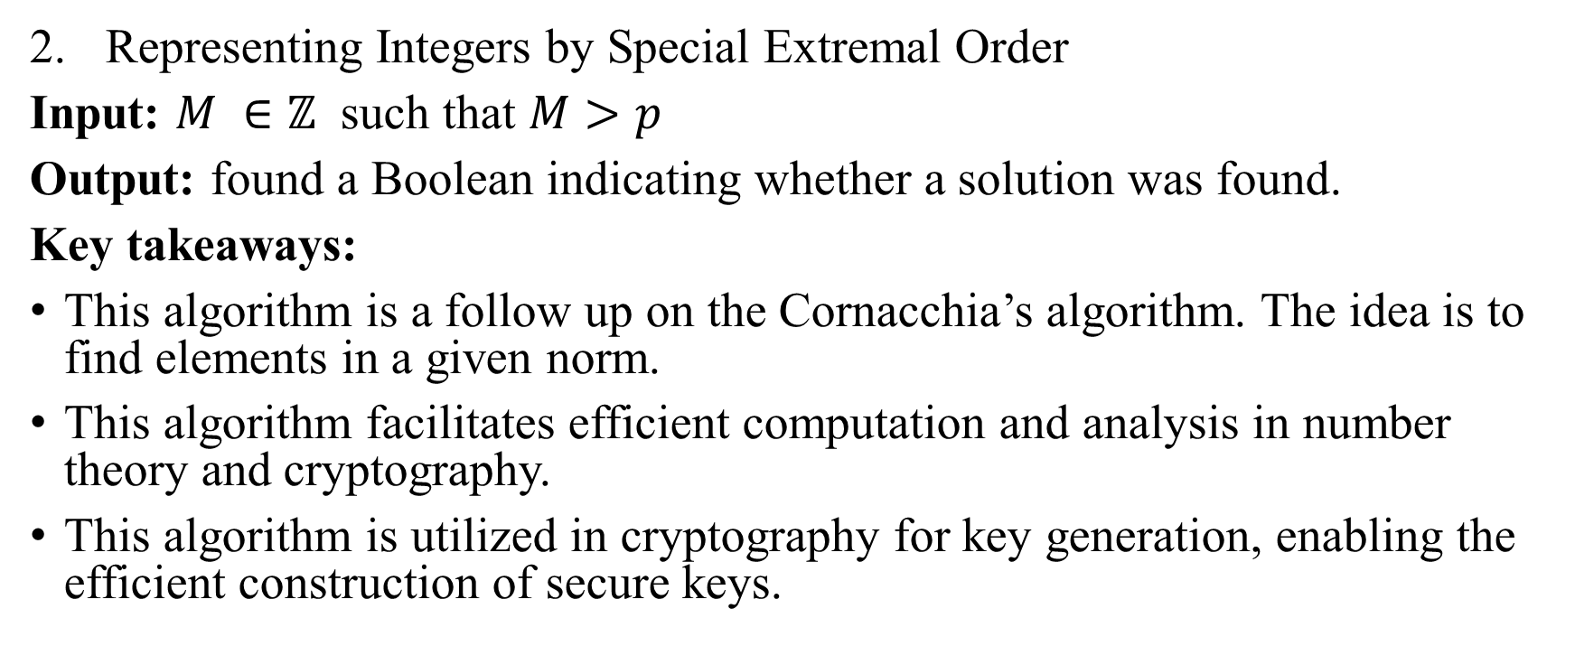
Algorithm Process Overview
Representing Integers by Special Extremal Order
Input: $M ∈ℤ$ such that $M>p$
Output: found a Boolean indicating whether a solution was found.
Key takeaways:
This algorithm is a follow up on the Cornacchia’s algorithm. The idea is to find elements in a given norm.
This algorithm facilitates efficient computation and analysis in number theory and cryptography.
This algorithm is utilized in cryptography for key generation, enabling the efficient construction of secure keys.

Slide 36
Conclusion
The essence of solving norm equations and how these algorithms and equations are essential in cryptography is to provide for integrity and non-repudiation of cryptographic systems like in SQI_{SIGN}.
Integrity provides us with the ability to make sure a message sent is a message received where nothing in the message changes.
Non-repudiation provides us with the ability to verify whoever sends a digitally signed message cannot be in denial of the message coming from the person who sent it.
Solving norm equations provides us with the ability to ensure that messages can be digitally secure and encoded which enhances the security of digital communications.

